Slide 1
1st Educational Workshop of Simulation Lab, ETH, 1st Oct 2015
Rajesh Mathew Pattupara
Long-term evolution of the Swiss electricity system under a European electricity market: Development and application of a cluster of TIMES electricity models
PSI,
01 October 2015

Slide 2
Outline
Introduction – Background and Motivation
CROSSTEM model
TIMES modelling framework
Scenarios & Key Assumptions
Results
Model limitations, issues and challenges
Conclusions

Slide 3
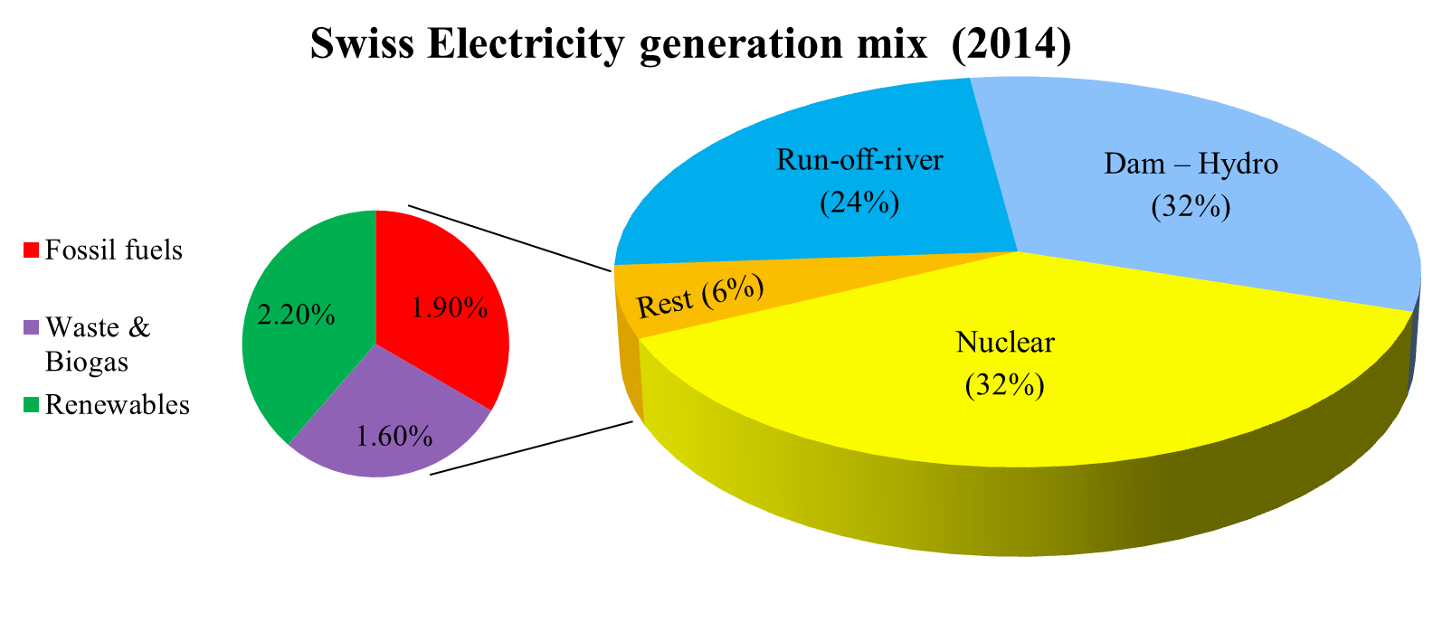
Introduction
Electricity accounts for one quarter of Swiss energy demand
Large differences in seasonal output, seasonal demand.
Creates seasonal dependence on electricity import.
Source: “Schweizerische Elektrizitätsstatistik 2013”, BFE Bern
Notes:
Important for energy security
Source of revenue
Clean source of energy

Slide 4
Future of Electricity system
Objectives
Nuclear phase out – No replacement of existing Nuclear power plants at the end of their 50 year lifetime. Last power plant off grid by 2034.
Ambitious carbon reduction targets
Uncertainty regarding future electricity demand
Uncertainty regarding future supply options
Too long a timescale to make accurate predictions
Energy System models
Difficult to predict the future
Solution

Slide 5
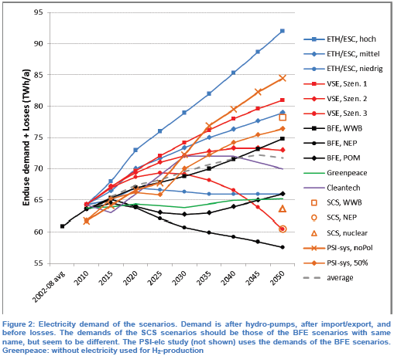
Forecasting future electricity system
Future demand pathways
Source: M. Densing, “Review of Swiss Electricity Scenarios 2050”, PSI (2014)
Notes:
Each study their own assumptions on demand drivers and their influence
Not just efficiency measures
But behavioral changes needed and assumed
PSI sys study – whole energy system model – endogenous electricity demand - elc demand increasing – to increase efficiency in the energy system and substitute combusted oil products
A demand-side model determines the energy demands based on assumed pathways of population
and of GDP, as well as by assumptions on structural changes, electricity prices and “technological
innovations” [1] (p. 9). The model seems to be a simulation (or accounting) model; unfortunately,
many more details are not disclosed in the study itself
Demand-side models: Each demand sectors of the energy systems, that is, residential, commercial,
industry and transport sector, has a simulation model to project energy demands. For example, demand
for household appliances is calculated as follows. The set of appliances is partitioned in detail,
for example in different cooling, heating, electronic media, and lighting devices with own input assumptions.
The time series that are input to the model are: the number of households, the devices’
efficiency, their size per household (includes an assumed substitution by other devices) and lifetime of
the devices. The current demand is simply obtained by dividing the number of devices by its assumed
efficiency, and summing over the devices. Some of the input parameters depend on policy assumptions,
for example the efficiency and size; see Figure 4, Figure 5, and [33] (p. 15).

Slide 6
Forecasting future electricity system – Supply options
Developments in Europe
Integration of intermittent Renewables
Nuclear phase-out?
CO₂ emission targets
Gas imports
Cost implications of renewable / low carbon policy
Revenue from trade
Evolution of fuel prices
Electricity
Supply Options
Gas
Renewables
Import
Supply Security
Cost of Supply
Climate change
System balancing
Balancing supply and demand
Intermittent nature of renewables
Electricity imports
CO2 emission targets
Expansion of Gas plants
Notes:
Gas supply from Russia ? – international politics
CO2 emissions – international policies – supply security
Technological advances

Slide 7
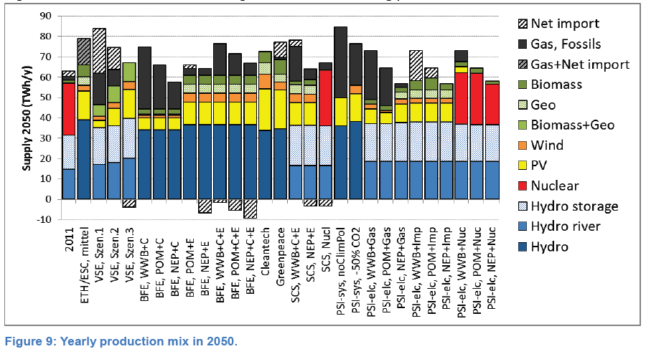
Electricity supply mix – Switzerland (2050)
Source: M. Densing, “Review of Swiss Electricity Scenarios 2050”, PSI (2014)
Notes:
One of the problems -> Intermittency of renewables have to be represented.
Long term capacity planning models have low temporal resolution – could have high impact for intermittent renewables.
Low temporal resolution ->inaccurate representation of residual load curve ->sub optimal investments and overestimation in uptake of IHRES and understimation of operational costs when compared with Unit commitment models (low tempresolution vs UC model underperdicts by 3-58% based on share of IHRES, hightemp vs UC model 3-23%).
All the abovementioned models except PSI-elc (STEM-E) have low time resolution – they cross check with UC models
2nd drawback – single region models – exogenous assumptions regarding imports/exports.

Slide 8
STEM-E – Swiss TIMES Electricity Model
Model Features
Single region model
Time horizon: 2000 – 2100
An hourly timeslice
Characterization of about 140 technologies and over 40 energy and emission commodities
Key Parameters
Exogenous electricity demand for the future
Range of primary energy resources
Exogenous electricity import and export from four countries
R Kannan & H. Turton (2011) - Documentation on the development of the Swiss TIMES electricity model
Available at http://energyeconomics.web.psi.ch/Publications/Other_Reports/PSI-Bericht%2011-03.pdf
Notes:
Why model caliberated to 2000-2010 – not all data available for 2010…so historical AF, EFF used for caliberation…
See Cost of ad hoc- limitations – why trade not good
Instead of modelling 8760 hours – year split into 288 hours

Slide 9
Electricity supply mix – Switzerland (2050)
Source: M. Densing, “Review of Swiss Electricity Scenarios 2050”, PSI (2014)
Notes:
One of the problems -> Intermittency of renewables have to be represented.
Long term capacity planning models have low temporal resolution – could have high impact for intermittent renewables.
Low temporal resolution ->inaccurate representation of residual load curve ->sub optimal investments and overestimation in uptake of IHRES and understimation of operational costs when compared with Unit commitment models (low tempresolution vs UC model underperdicts by 3-58% based on share of IHRES, hightemp vs UC model 3-23%).
All the abovementioned models except PSI-elc (STEM-E) have low time resolution – they cross check with UC models
2nd drawback – single region models – exogenous assumptions regarding imports/exports.

Slide 10
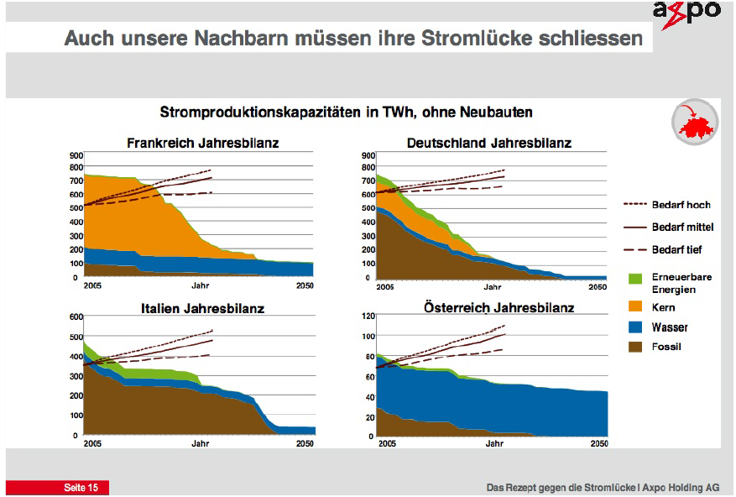
Where do the imports come from?
Situation in neighbouring countries
Source: N. Zepf, “Das Rezept gegen die Stromlücke”, AXPO (2003)
Notes:
One also has to note that other countries are not standing still – they also have their own ambitions, targets, or challenges however you want to call them.
Only VSE study deals with this to a certain extent

Slide 11
Why the need for a new model ?
Objectives:
Understand the developments in the neighbouring countries – Germany (DE), Austria (AT), France (FR) and Italy (IT).
Quantify the extent to which these developments affect the Swiss electricity sector.
Notes:
Switzerland – needs to account for variability in demands and supply (high level of intertemporal details

Slide 12
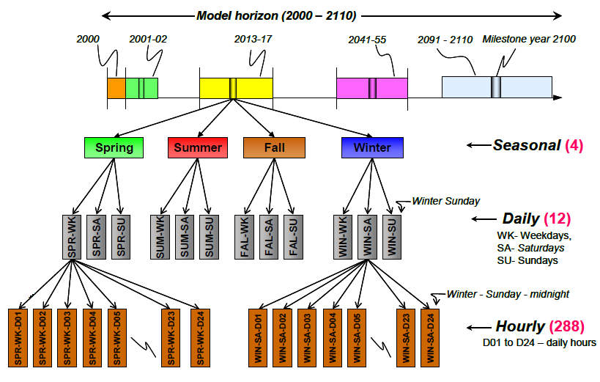
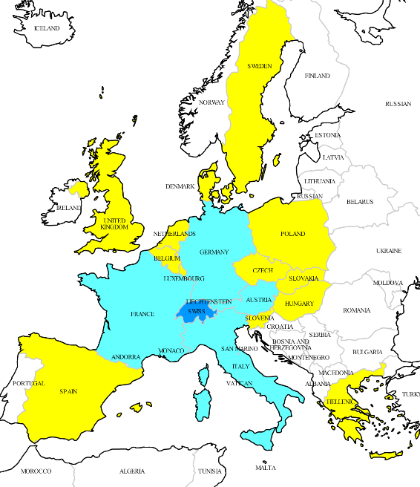
CROSSTEM Model
CROSs border Swiss TIMES Electricity Model
Extension of the STEM-E model to include the four neighbouring countries
Time horizon: 2000 – 2050 in
An hourly timeslice (288 timeslices)
Detailed reference electricity system with resource supply, renewable potentials and demands for 5 countries
Calibrated for electricity demand and supply data between 2000-2010
Endogenous electricity import / export based on costs and technical characteristics
Notes:
Why 2000-2010 – not all data available for 2010, incomplete…so avergae AF and EFF etc used…to avoid singel year error..
Time hoizon – long time horizon,
Timeslice – intertemporal detail
And detailed reference electricity system – with all the

Slide 13
TIMES modelling framework
TIMES – The Integrated MARKAL / EFOM System
Technology rich, Perfect foresight, cost optimization framework
Used to explore a range of parametric sensitivities under a “what-if” framework via exploratory scenario analysis.
Integrated modelling of the entire energy system
Prospective analysis on a long term horizon (20-50-100 yrs)
Allows for representation of high level of temporal detail – load curves
Enhanced Storage algorithm – modelling of pumped storage systems
Optimal technology choice – based on costs, environmental criteria and other constraints.
MARKAL – MARKet ALlocation
EFOM – Energy Flow Optimization Model

Slide 14
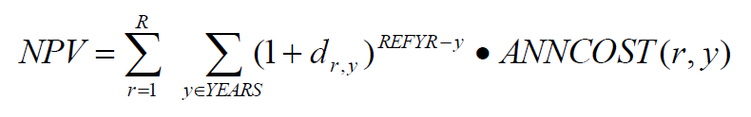
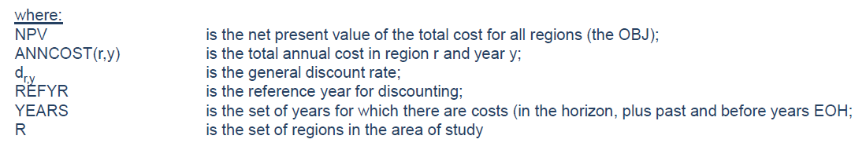
TIMES modelling framework
The TIMES Objective Function – is the discounted sum of the annual costs minus revenues
The total cost includes the following elements
Construction | + Investment costs for installing new processes
Operation | + FOM & VOM
 | + Cost for domestic resource production
 | + Cost for exogenous imports
 | + Delivery costs for required commodities consumed by processes
 | + Taxes on commodity / process activities or investments
 | - Subsidies on commodity / process activities or investments
 | - Revenues from exogenous exports
Decommissioning | - Salvage value of processes at the end of the planning horizon

Slide 15
Application of CROSSTEM
Alternative low carbon electricity pathways in Europe and knock-on effects on the Swiss electricity system

Slide 16
Scenario Overview
 | CROSSTEM Scenarios
Least Cost | Baseline scenario No particular constraints in technology investment* EU-20-20-20 targets applied for emissions and renewable based generation
No Nuclear (noNUC) | Nuclear Phase-out scenario Nuclear phase-out in Switzerland by 2034 (50 year lifetime), in Germany by 2023, France to reduce nuclear share to 50% of total elc generation by 2025 and beyond All other conditions same as LC
Climate Target (CO2) | De-carbonization of power sector (95% CO₂ reduction by 2050 from 1990 levels) for all five countries together All other conditions same as noNUC.
* except where already part of policy: No nuclear investment in Italy (IT) and Austria (AT). No Coal investment in Switzerland (CH). Nuclear fleet can be replaced up to todays level.

Slide 17
Key assumptions
Input Assumptions
Electricity Demand – EU Trends to 2050 (Reference scenario), BAU demands for CH (SES 2050)
Trade with “fringe regions” – Historical limits applied
CO2 price – European ETS prices implemented (SES 2050, Bfe)
Fuel Prices – International fuel prices from WEO 2010.
Methodological Assumptions
Copper Plate regions – No transmission and distribution infrastructure within each country. Interconnectors between regions.
.
Notes:
Talked about technology learning curves etc…
Growth (%)
2010 – 2050
AT - 2.4%
FR - 4.1%
DE - 1.3%
IT - 3.2%
CH – 17%
Lignite cost from personal communication with Birgit G

Slide 18
Results – Electricity generation mix
Switzerland – All CROSSTEM scenarios
noNUC – Nuclear power replaced by gas power; reduced imports as it is more expensive
CO2 – Gas CCS + Geothermal for baseload; Net exporter by 2050 – Due to the availability of CCS storage
Notes:
Why imports in LeastCost- 9% in 2050, 6% in noNUC Because limit on nuclear
CO2 scenario – Demand increase in other regions very high – Exhausting their CCS and renewable potentials
As CH has CCS storage potential it can export.

Slide 19
Results – Electricity generation mix
Electricity generation mix 2050
Notes:
Coal + coal ccs over gas due to emissions + wind technology more cost effective…Gas 90% flexible generation to supplement flexible hydro…
Else wind and coal and coal CCS most cost effective.
CO2 scenario – Germany exhausted…becomes net importer… one of the exporters is CH..one is austria…and one is france… italy not because of no direct border else has to go through CH…
Second part can only be explained by load curves…

Slide 20
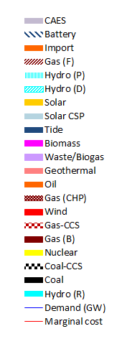
Results – Electricity generation schedules
Load Curve – Summer Weekday 2050 (CO2)

Slide 21
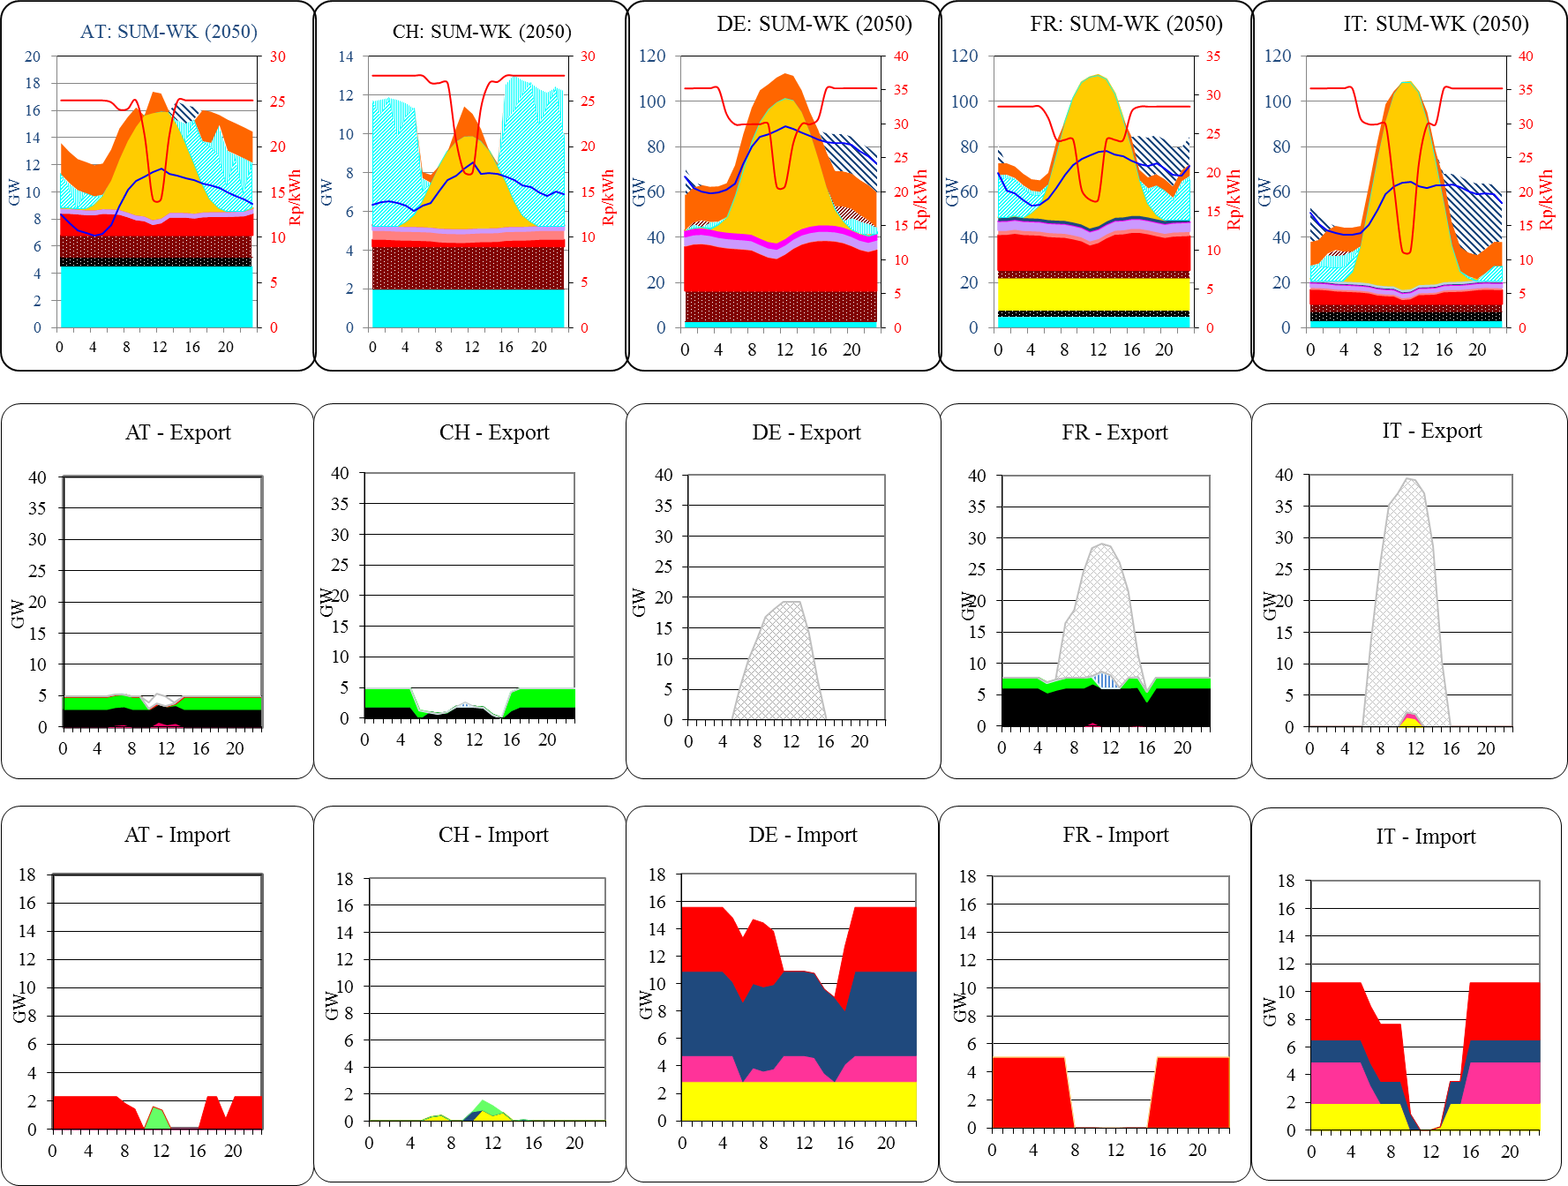
Load Curve – Summer Weekday 2050 (CO2)

Slide 22
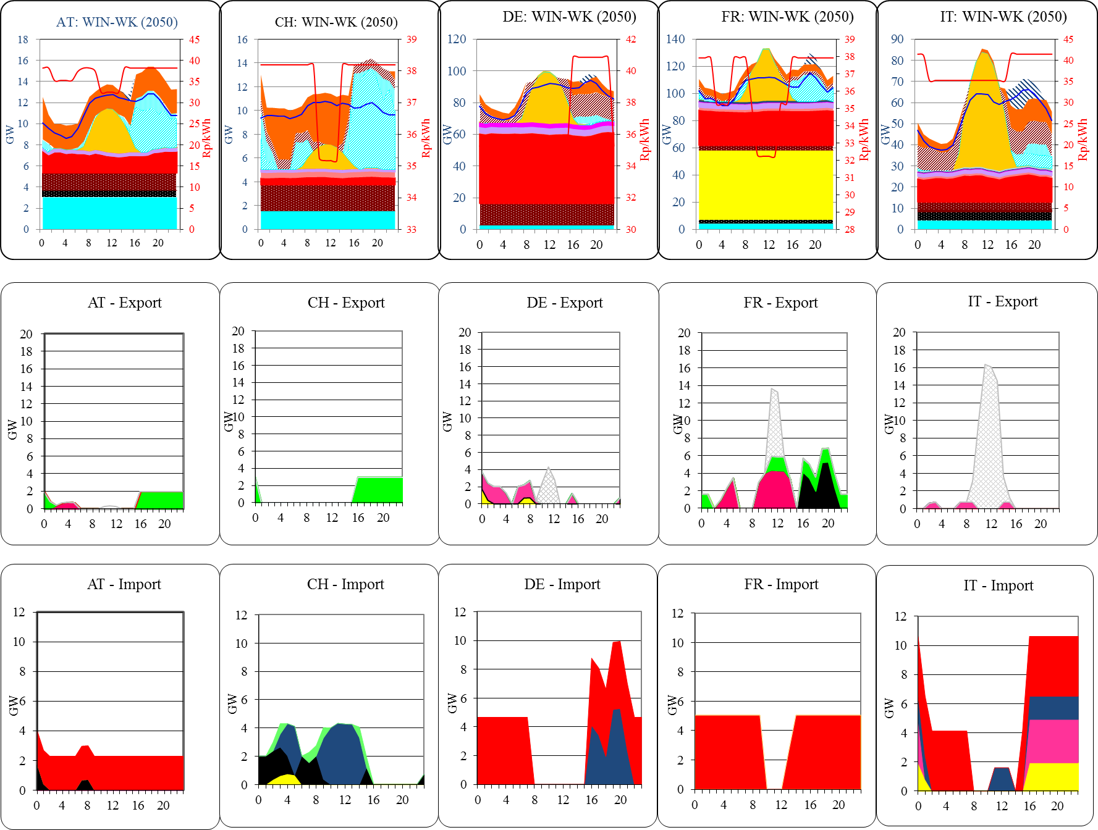
Load Curve – Winter Weekday 2050 (CO2)

Slide 23
Results – Total System Costs
Capital Outlay per period
Capital Investment highest for CO2 scenario, lowest for noNUC
Total System Cost (excl Trade Cost/Revenue): LeastCost – 275 bio CHF, NoNUC – 305 bio CHF, CO2 – 332 bio CHF
Notes:
NoNUC has gas plant investments – lower than Nuclear or renewables
When Total System Costs are looked at, fuel prices also come into play which makes noNUC more expensive than LC. CO2 still expensive
Once you include trade revenue, it’s a much different picture – CO2 becomes less expensive than NoNUC – only because of its CCS potentials

Slide 24
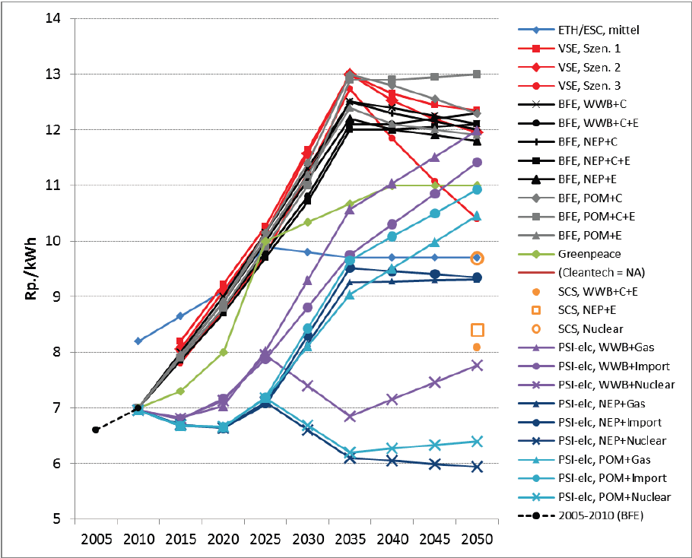
Electricity generation Cost
noNUC
CO2
LC
noNUC-CHSS
CO2-SS
CO2-LowCCS
Source: M. Densing, “Review of Swiss Electricity Scenarios 2050”, PSI (2014)

Slide 25
Model Limitations
Limitations & Uncertainties
CROSSTEM is not a pure dispatch model
Modelling of representative days – Overall simplifications
Trade with fringe regions – Inclusion of surrounding countries
T&D infrastructure not explicitly modelled.
CO2 transport across countries not modelled
Model assumes perfect information, perfect foresight, well functioning markets and economically rational decisions – Optimal solution for 5 countries together, not for each country
PSI,
1. Oktober 2015
Notes:
No ramp up/ramp down
Model represents perfect sunny day and wind…not the case..alll winter weekdays will not be windy…wind as covering a lot of baseload…back up generation will be required..if necessary for all the 200 GW of wind and 100 GW of Solar..

Slide 26
The CROSSTEM Universe
CROSSTEM
EUSTEM
CROSSTEM-HG
Account for renewable intermittency
Test adequacy of storage investments
Effects of fringe regions
Notes:
Quantify effect of fringe region

Slide 27
Conclusions - CROSSTEM
A new electricity system model for Switzerland with an emphasis on cross-border trade has been developed
Various scenario explorations conducted to test robustness of model
Feasibility of a low carbon electricity pathway has been demonstrated
Notes:
CCS scenario, nuclear phaseout – and their effects on switzerland explored

Slide 28
Thank you for your attention !!!
PSI,
1. Oktober 2015

Slide 29
Energy Economics Group
Laboratory for Energy Systems Analysis
General Energy Research department & Nuclear Energy and Safety Research Department
PSI,
1. Oktober 2015

Slide 30
Backup Slides

Slide 31
Load Curve – Winter Weekday 2050 (CO2)
Modelling of representative days – While generating valuable insights - Overall simplifications in wind and solar profiles
Trade with fringe regions – Load dumping (market for export) and load balancing (source of import)

Slide 32
The CROSSTEM Universe
CROSSTEM
EUSTEM
CROSSTEM-HG
Account for renewable intermittency
Test adequacy of storage investments
Effects of fringe regions
Notes:
Quantify effect of fringe region

Slide 33
Average vs real renewable profiles (solar + wind)
Notes:
Needs to be storage that can store this excess energy…. Or an equivalent flexible technology that can cope with this…
We don’t know if curtailment is in here – we assume not
Or a combination of the both…..

Slide 34
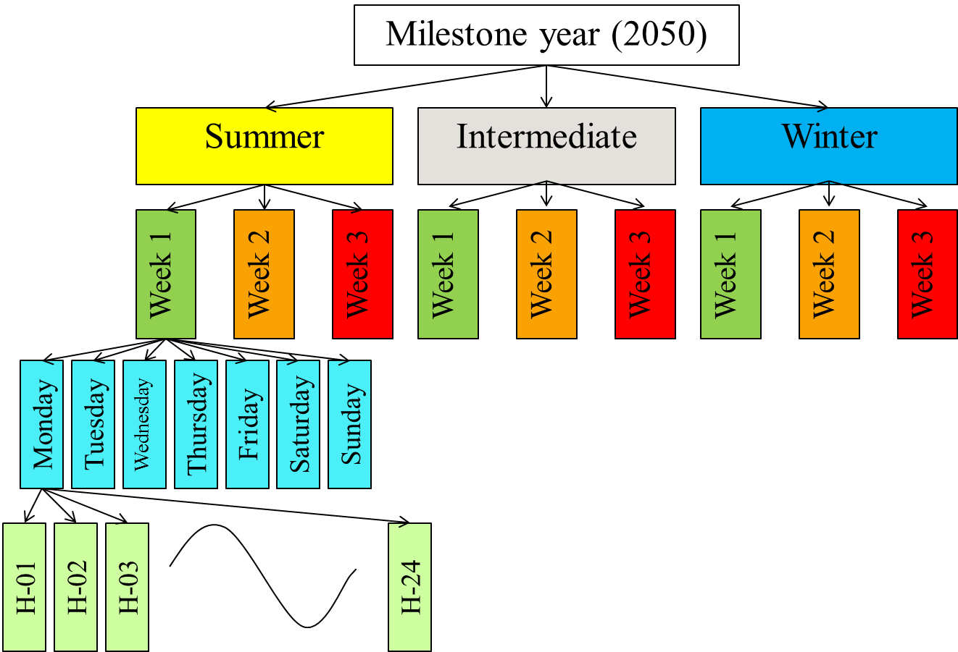
CROSSTEM-Hourly-Generation (HG) model
Snapshot version of CROSSTEM – Focus on 1 particular year
No capacity investment – Investment data taken from CROSSTEM scenario run
Higher time resolution
Can the given CROSSTEM capacity mix satisfy the demand under varying solar and wind profiles?
3 Seasons
3 Weeks a season
7 days a week
24 hours a day
3 * 3 * 7 * 24 = 1512 timeslices
Notes:
Can the model satisfy the demand using the capacity investment decisions made in CROSSTEM
Does it have enough storage and flexible generation
We have seen In CROSSTEM – Avrage profiles – No problem
But what about on an hourly level

Slide 35
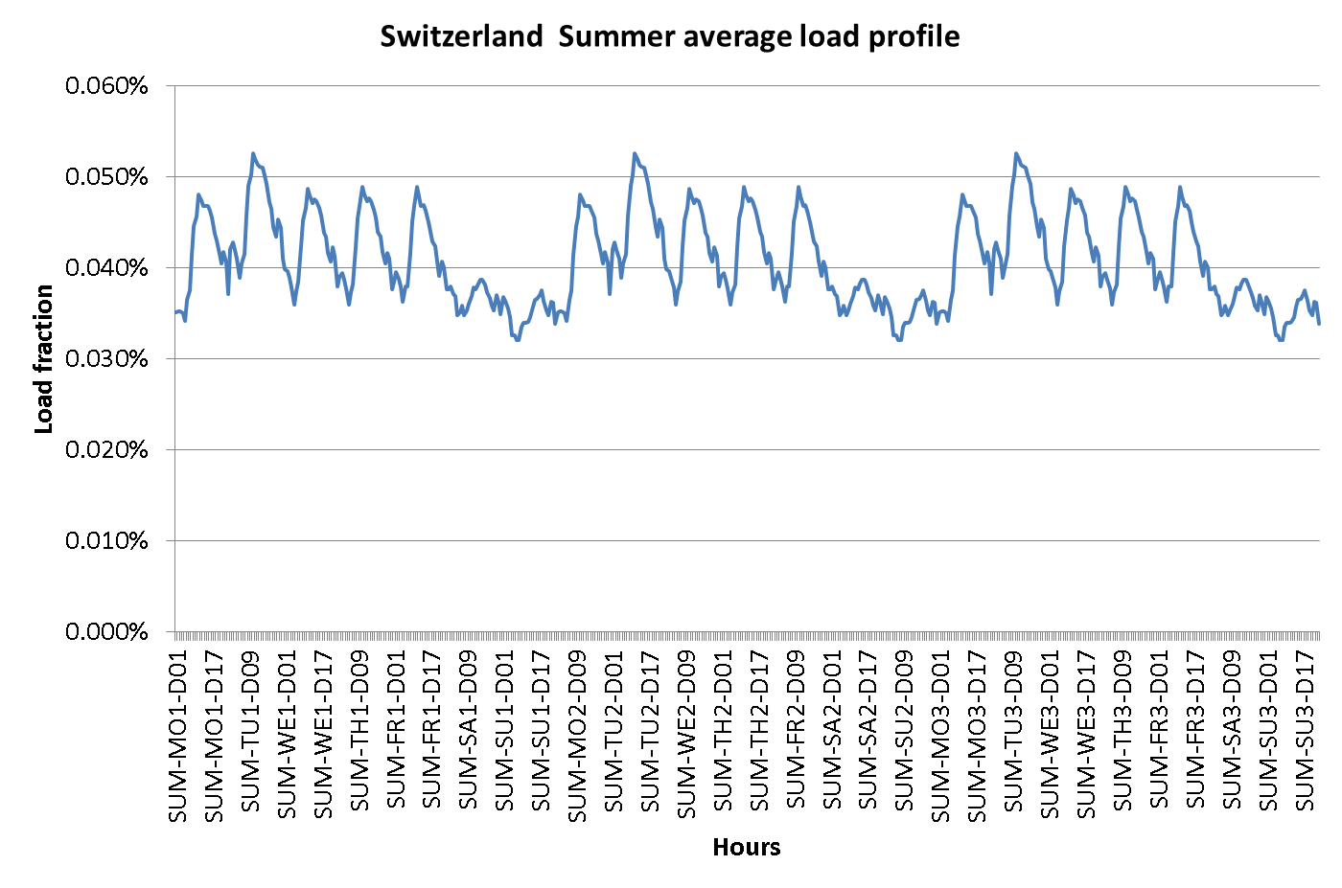
CROSSTEM-HG: Input Data
Capacity Data taken from a CROSSTEM Run for 2050
Electricity trade with fringe regions fixed
Average load curve from 2010
Solar and Wind profiles – Random selection of actual wind and solar generation profiles, for three consecutive weeks (German data used for DE, CH and AT; French data for FR, IT)
Ramp up/ramp down constraints applied – 11% per hour for river hydro, 2% for remaining plants. Flexible hydro and gas plants have no constraint
Notes:
Capacity for all regions – Decarbonization scenario…
Solar and Wind – quasi fixed generation due to fixed capacity and availability numbers… Solar also allowed to be curtailled… (curtailement in CROSSTEM not taken into account – hence availability factor of 48% not 40% from CROSSTEM)
Introduce some level of stochasticity
Trade – net importer no net exporter, all that is kept from CROSSTEM – Just actual trade numbers not fixed..some flexibility needed…
Some imports from Others allowed….shown in trade results..
Model was developed in last three weeks…so I have not got a 100% grasp on it yet….still need a lot of analysing…but I will try my best to explain the result and answer your questions….

Slide 36
CROSSTEM-Dispatch: Results
Notes:
Switzerland still a net exporter in summer… solar and dam hydro is used to balance the load…river hydro also plays a role, reducing during high solar hours…and weekends…

Slide 39
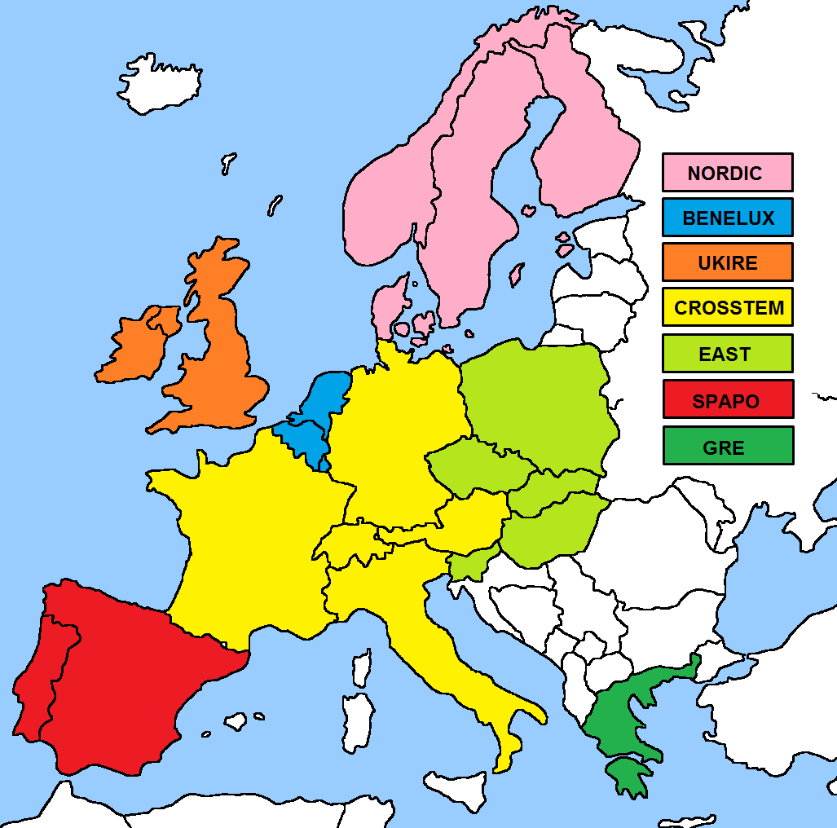
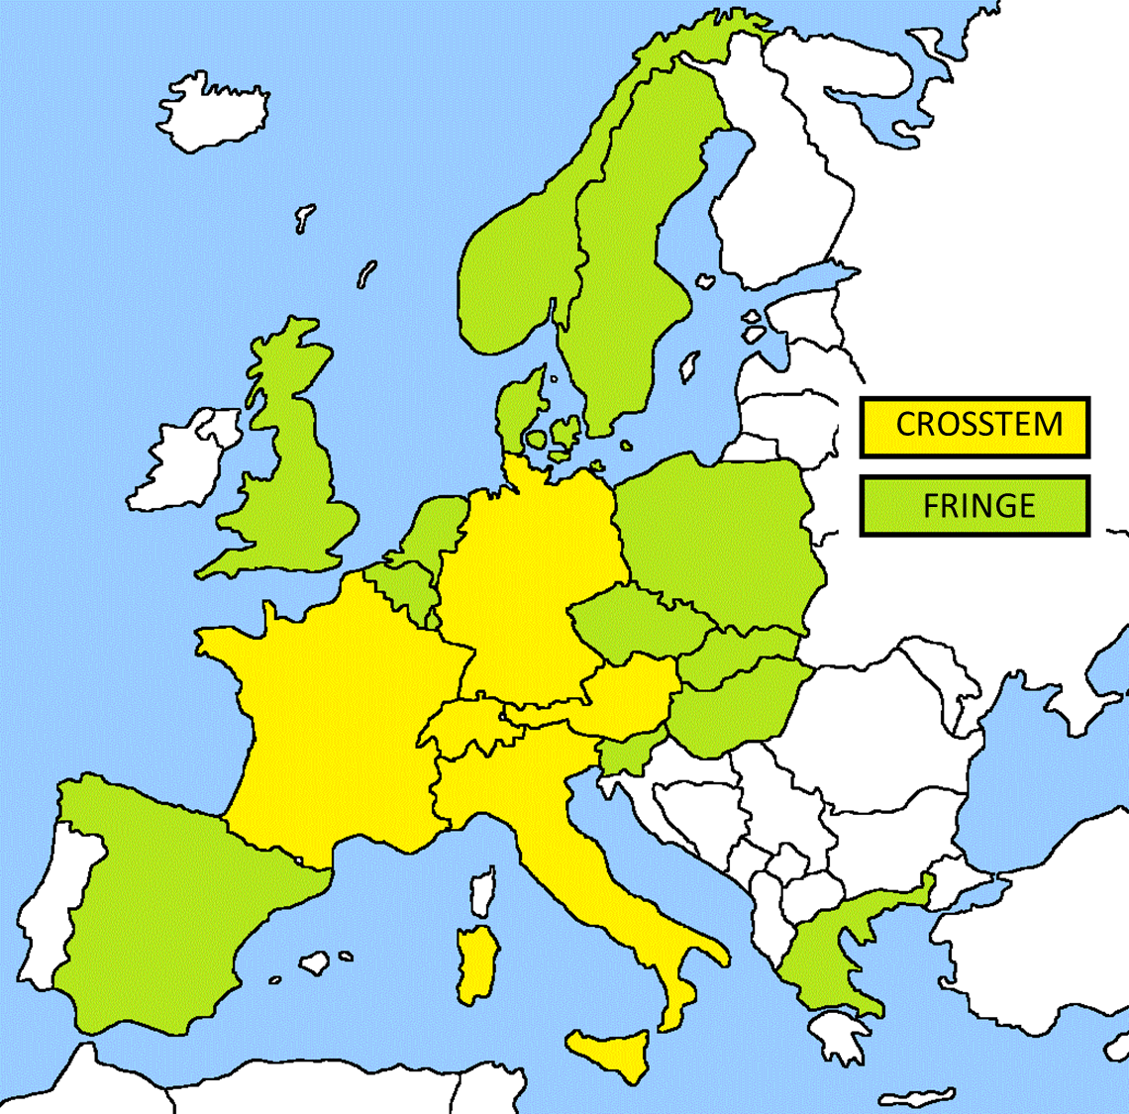
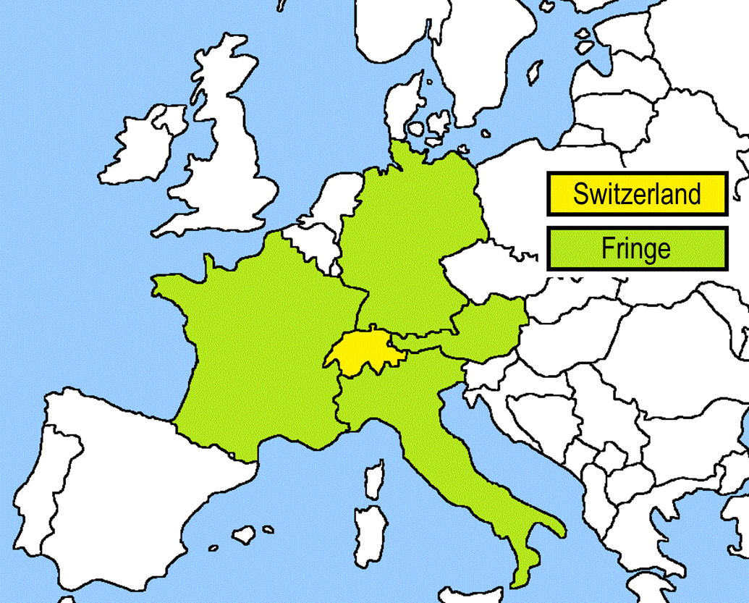
Evolution of the Swiss TIMES Electricity models
Extended to include 6 additional regions (11 regions in total) in a European TIMES Electricity Model
Encompass 20 out of EU-28 countries (plus Switzerland and Norway)
Covers 96% of electricity generation and 90% of total installed capacity
Notes:
Is bigger always better
Taken the electricity system for all countries….96% of total generation, 90% of installed capacity of EU28 + CH + NOR

Slide 41
Conclusions – CROSSTEM-HG & EUSTEM
Model of the electricity system of Switzerland and Europe over a long term horizon combined with dispatch aspect achieved.
Effects of surrounding country developments on the Swiss electricity system are observed – but how significant
Is bigger always better – Are results from a bigger model significantly different from CROSSTEM when analysing Swiss results ?
Master Thesis (Ms. Raluca Anisie): Comparison of EUSTEM vs CROSSTEM scenarios
Notes:
We have seen how

Slide 43
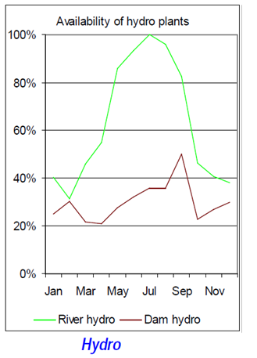
Seasonal demand – supply variation
Hydro resource availability - Switzerland
Source: “Documentation on the development of the STEM-E model”, PSI (2011)

Slide 44
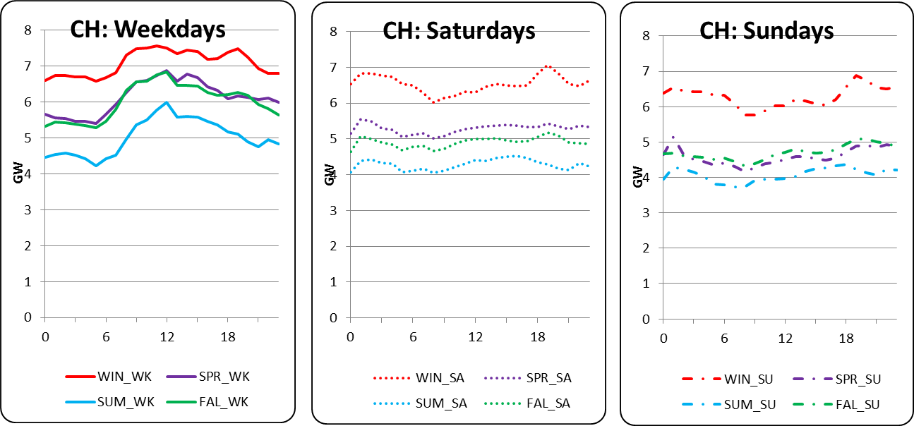
Seasonal demand – demand variation
Electricity demand pattern - Switzerland
Source: Data provided by ENTSO-E

Slide 45
Energy System Models
Why Energy System Models?
Purpose of models is to generate insights, not forecasting
Long term strategic planning via “what-if” scenarios – Implication of changes to parts of the system under certain boundary conditions
Assist policy makers to make decisions in order to fulfil given policy goals
Optimization models (MARKAL, TIMES)
Simulation models (NEMS, PRIMES)
Power systems and electricity market models (WASP, PLEXOS)
Qualitative and mixed method scenarios
Objective
Comparitive study: Pfenninger et.al, “Energy Systems modelling for 21st century energy challenges”, London (2014)
Notes:
Under certain given boundary conditions…what if one aspect was changed…what would be the cost optimal solution…how would the technology mix look like… what are the CO2 emissions like etc.etc.
Modelling not completely useless…please don’t say otherwise cause you will break my heart…
gy policy began after oil crisis in 70s
Optimization – in cost/emissions/other factors disadvantage – resolution in time and space
Simulation – no optimization – but behaviours are simulated to see effects – problem is complex and uncertainty high (results difficult to explain), and transparancy low
Market models – focus on temporal resolution (hourly, 15 min, even 1 min) – usually no capacity expansion and over shorter timescales
Qualitative – simple models, transparent, to check technical and economic feasibility, simple calculations to show extent to which different technologies could reduce emissions. – disadv – no human factors included (political will, behaviour, public acceptance)

Slide 47
European electricity modelling approaches
Dispatch-type models
Prognos
ZEPHYR
(Pöyry)
EPOD
(Johnsson)
DIME
(EWI)
Inter-temporal detail
ATLANTIS
(Gutschi)
Technology optimisation models
REBUS
(Voogt)
Pan-Euro TIMES
(Blesl)
ELOD
(Johnsson)
EuroMM
(Reiter)
Time horizon
“ELECTRA Kick-off meeting - CROSSTEM”, H. Turton & K. Ramachandran 19th July 2011
Voogt, 2001; Reiter, 2010; von Weizsäcker and Perner, 2001; Johnsson, 2011; Gutschi et al, 2009; Blesl, 2008; EWI, 2010; Prognos, 2010

Slide 48
European electricity modelling approaches
CROSSTEM
and focus on CH
Prognos
ZEPHYR
(Pöyry)
EPOD
(Johnsson)
DIME
(EWI)
Inter-temporal detail
ATLANTIS
(Gutschi)
REBUS
(Voogt)
Technology investment
Pan-Euro TIMES
(Blesl)
ELOD
(Johnsson)
EuroMM
(Reiter)
Time horizon
“ELECTRA Kick-off meeting - CROSSTEM”, H. Turton & K. Ramachandran 19th July 2011
Representation of Switzerland highly aggregated
Voogt, 2001; Reiter, 2010; von Weizsäcker and Perner, 2001; Johnsson, 2011; Gutschi et al, 2009; Blesl, 2008; EWI, 2010; Prognos, 2010

Slide 49
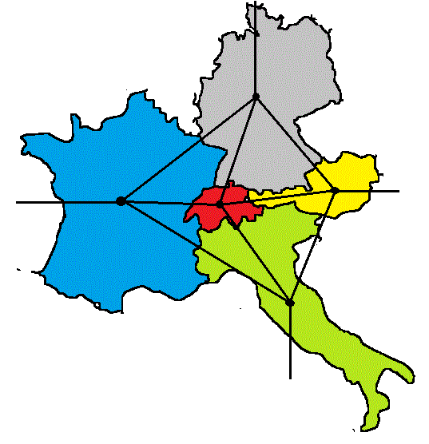
Interconnectors

Slide 50
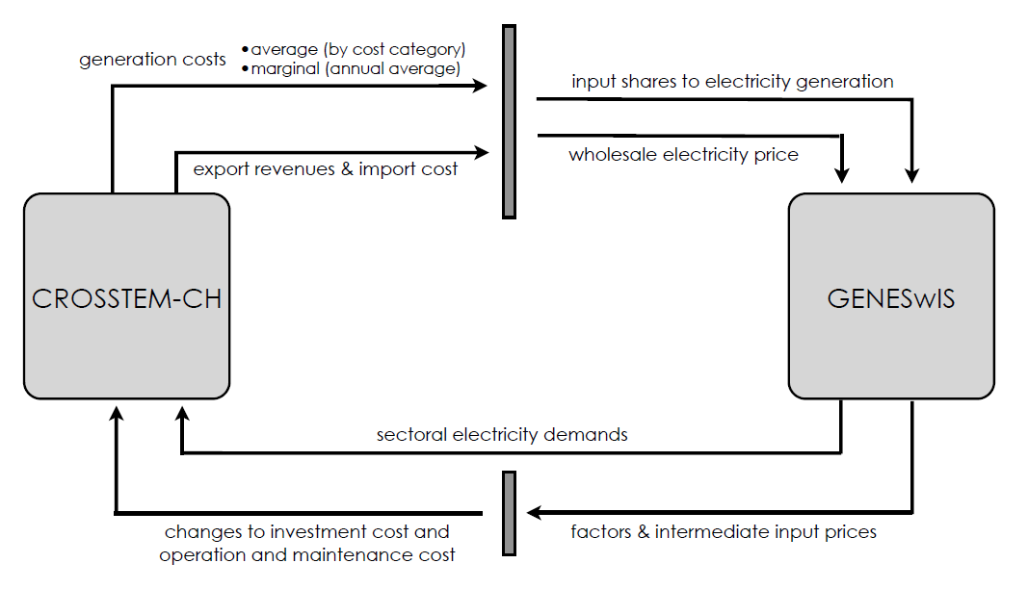
ELECTRA Project
3. “Coupling GENEWsIS and CROSSTEM-CH”, S. Maire, R. Pattupara, BfE Bern, April 2014

Slide 51
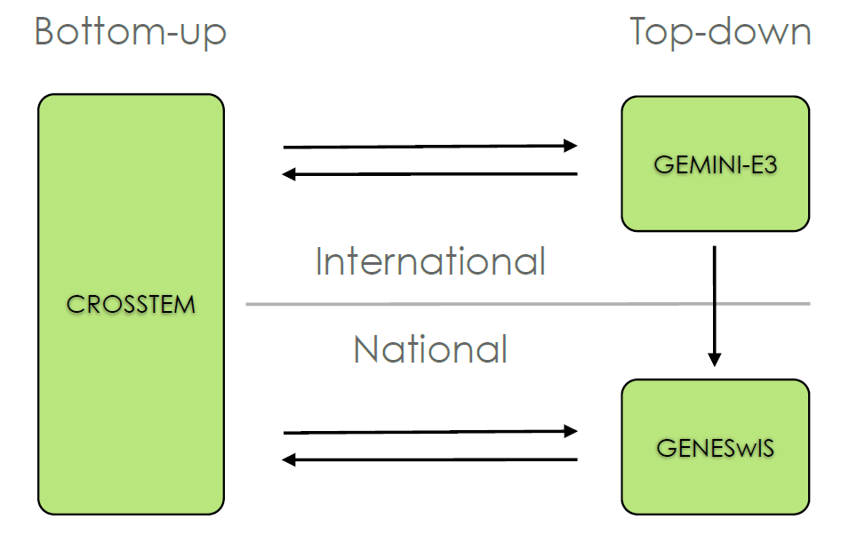
ELECTRA Project
4. “Coupling GENEWsIS and CROSSTEM-CH”, S. Maire, R. Pattupara, BfE Bern, April 2014

Slide 53
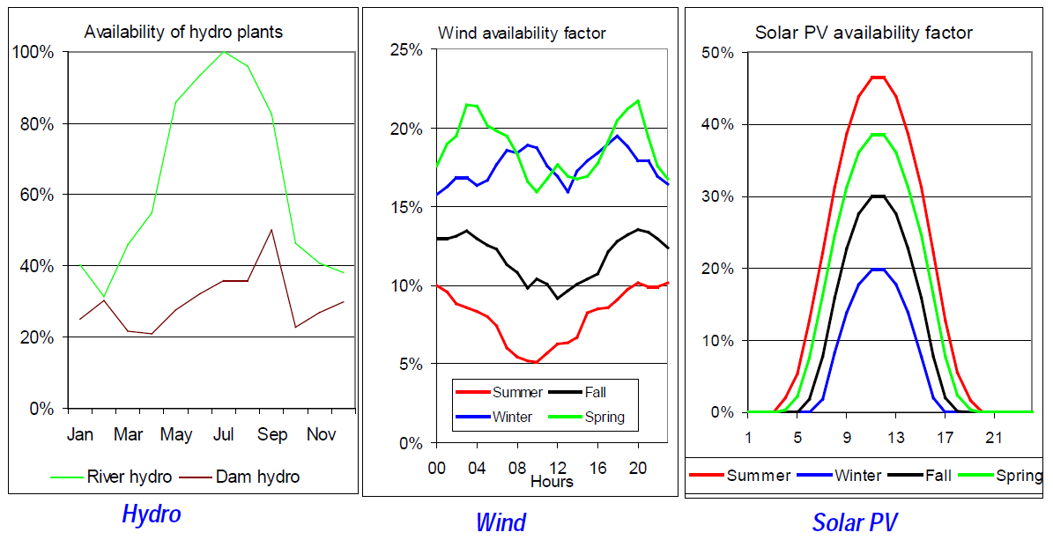
Forecasting future electricity system – Supply options
Intermittency of renewable sources of electricity
Source: “Documentation on the development of the STEM-E model”, PSI (2011)

Slide 54
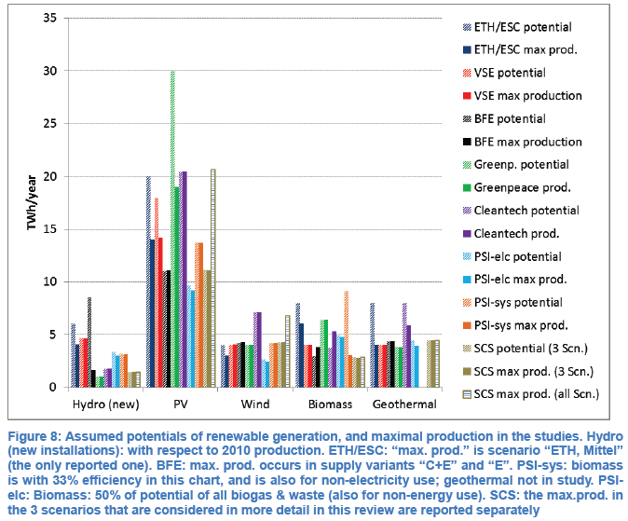
Forecasting future electricity system – Supply options
Renewable resource potentials
Source: M. Densing, “Review of Swiss Electricity Scenarios 2050”, PSI (2014)

Slide 55
Aggregated Results
Electricity generation mix (CH) – CROSSTEM-CH vs CROSSTEM
Notes:
Why Solar in single region vs no Solar in multi region – is it because of cheaper import prices in CROSSTEM – yes it is…once I put CROSSTEM MC into STEM-E run, I get no solar, but majority flexible gas… Also I import/export 250 instead of 190 in CROSSTEM-Ch and 120 in CROSSTEM. Next slide show the price differences. And check which season is importing and which season is exporting (see notes for hypothesis)…
hence winter demand more readily met with imports. – cross check it with another CROSSTEM-CH run with lower import/export prices.

Slide 56
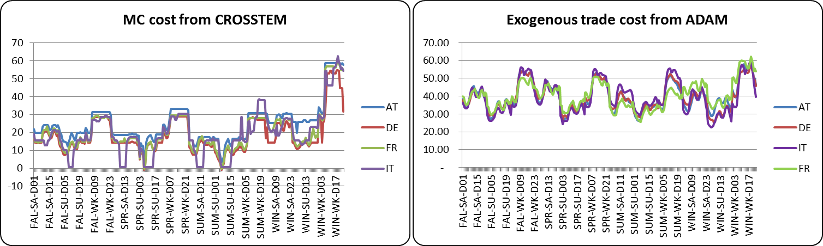

Slide 57
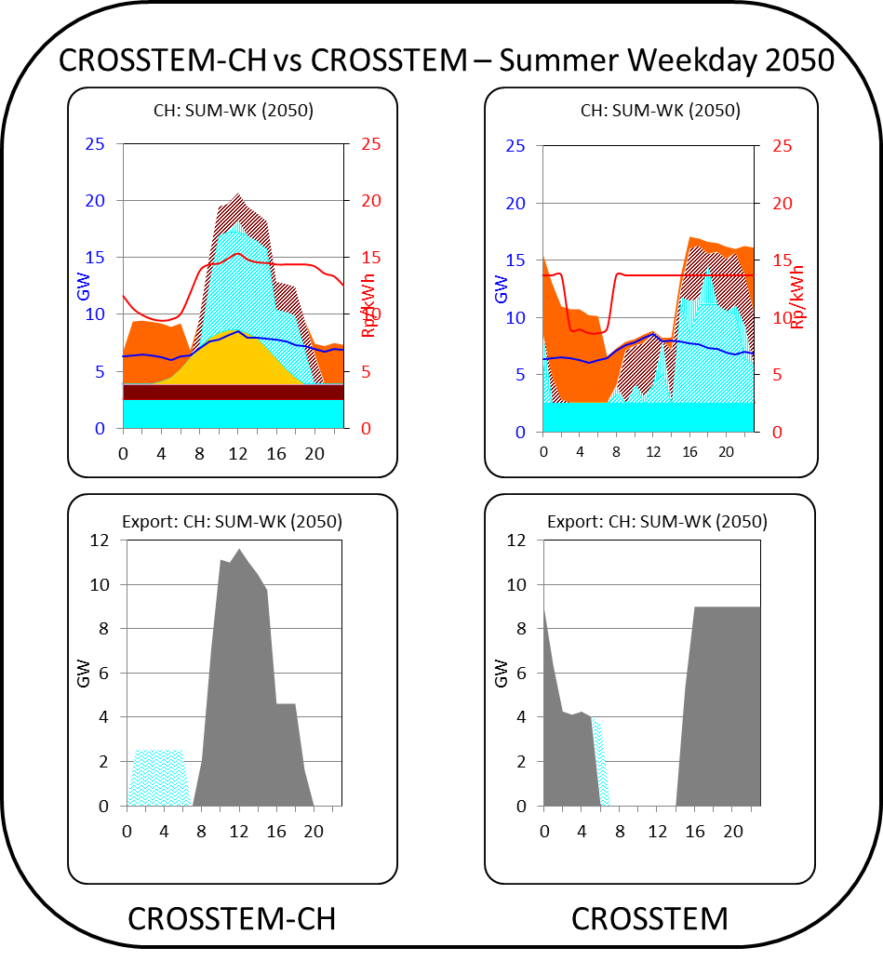
STEM-E vs CROSSTEM

Slide 58
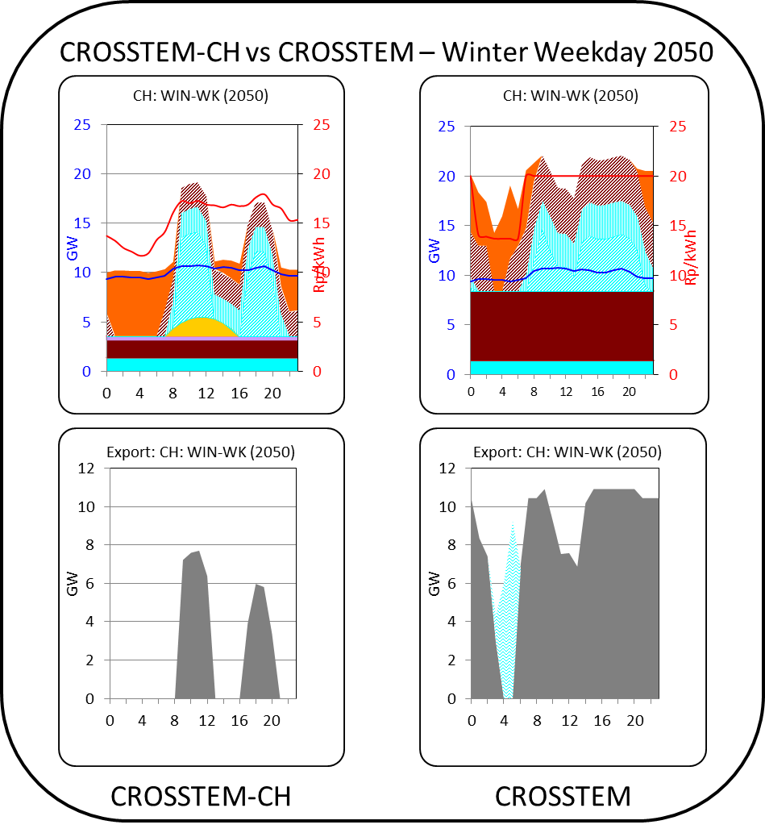
CROSSTEM-CH vs CROSSTEM
Notes:
Why the double peak in CROSSTEM-CH – show the electricity import/export price curves
Why the profile in CROSSTEM -> Go through the countrywise loadcurves – why switzerland doesn’t invest in solar in a baseline scenario, instead how it profits from surrounding countries.
Who is importing…why this difference??

Slide 59
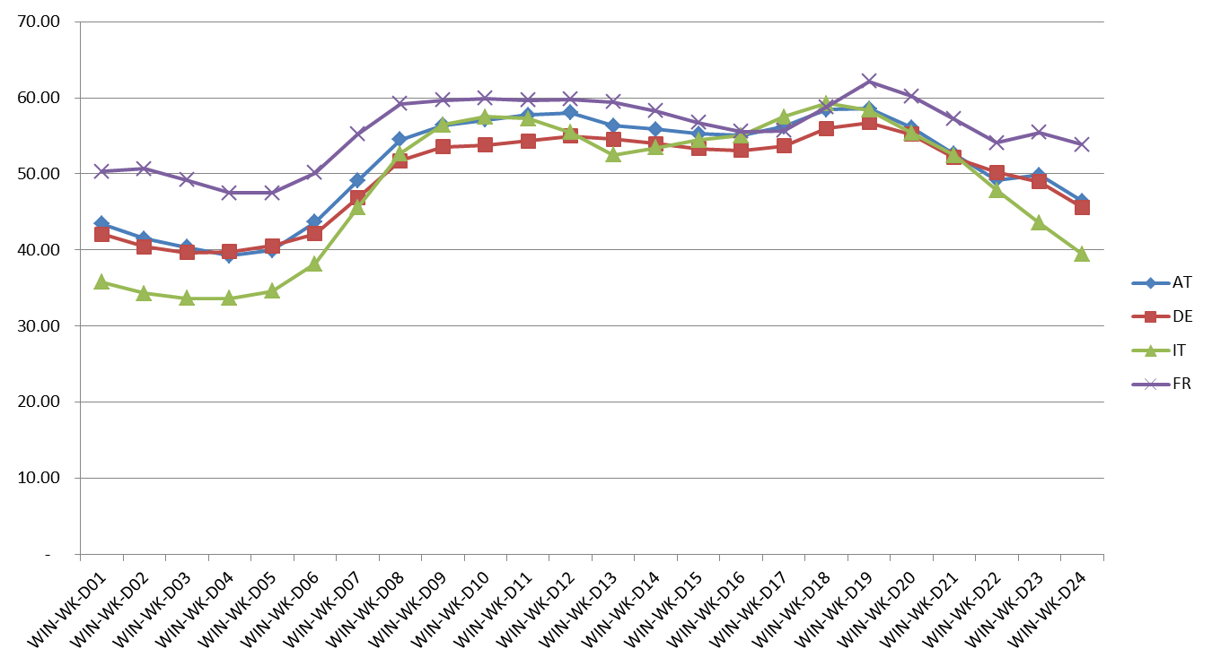

Slide 60
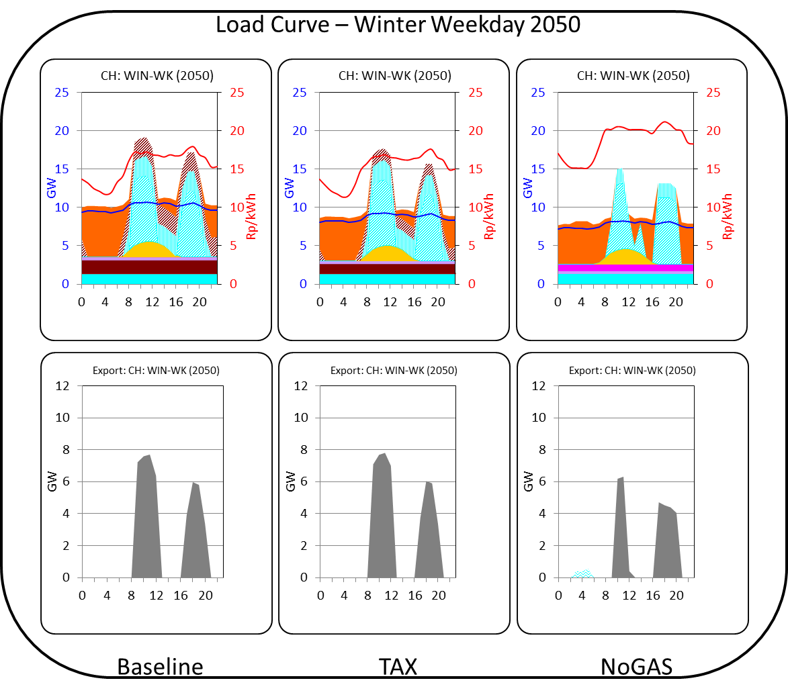

Slide 62
TIMES modelling framework
Exogenous inputs to TIMES
Demands and Parameters
End-use demands Demand elasticity Energy (materials) prices Reserve supply curves Other parameters Discount rate Time period Time slices
Technology database
Techno-economic attributes
Environmental
Emission coefficients Targets Taxes, subsidies Sectors’ measures
TIMES
Outputs from TIMES
Output
Technology Investments and annual activities Emission trajectories Adjusted demands for energy services Marginal prices of energy commodities Imports / Exports of energy and emission permits Total discounted system cost The least cost solution to satisfy energy service demands and constraints
ETSAP Training Course, IEA Paris, 12-14 June 2013
Notes:
Price elasticity of demand (PED or E_{d}) is a measure used in economics to show the responsiveness, or elasticity, of the quantity demanded of a good or service to a change in its price

Slide 63
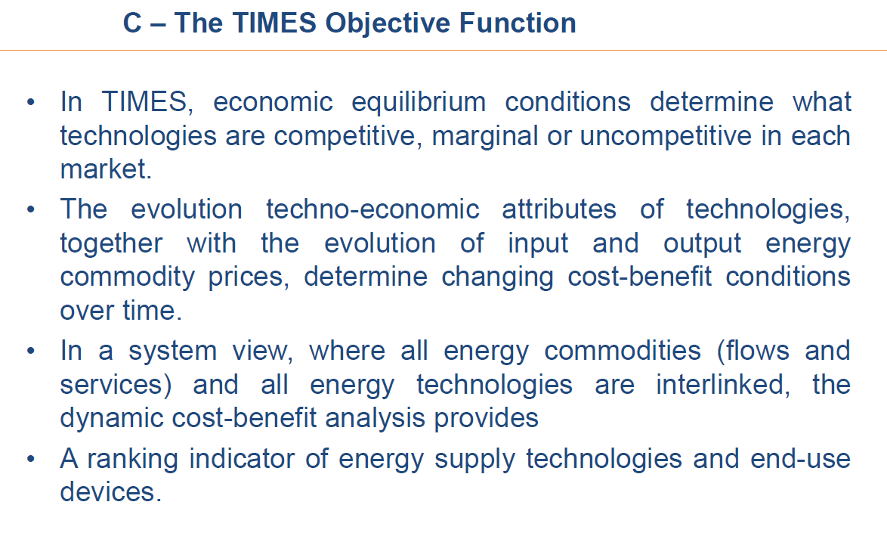

Slide 64
TIMES Framework
Linear programming (LP) model
Decision variables (positive, continuous):
Activity variables (Production level of technologies)
Energy flows
Investment decisions
Optimization problem
Objective function
Min
Model constraints
(linear constraints):
Energy/emission balances
Efficiency relationships
Utilization constraints
Peaking/reserve capacity
GHG mitigation targets, quotas for renewables,…
Standard TIMES model: Linear programming
Implemented in modeling environment GAMS (General Algebraic Modeling System) for optimization/equilibrium problems
Solution by interior point solvers (CPLEX, XPRESS)
Variants of TIMES:
  Macro economic module -> Non-linear eqns -> Non-linear programming
  Block-wise capacity expansion -> Binary variables -> Mixed-integer programming

Slide 65
TIMES Framework
Variables
Associated bound
parameters
vintage
period
actual
period
region
Process oriented:
  VAR_ACT(r,v,t,p,s): activity of a process
  VAR_CAP(r,v,p): installed capacity =
  new investments
  + past investments still existing
  VAR_NCAP(r,v,p): new investment in period v
Flow oriented:
  VAR_FLO(r,v,t,p,c,s): flow level of commodity c linked to process p
  VAR_IRE(all_reg,v,t,p,c,s,ie): inter-regional exchange variable
  VAR_SIN / VAR_SOUT(r,v,t,p,c,s): flows entering/leaving a process p storing a commodity c
process
lo,up or fx
timeslice
COAHAR
ELC
ACT_BND(r,t,p,s,l)
VAR_FLO
VAR_ACT
Coal plant
COASTM000
CAP_BND(r,v,p,l)
VAR_NCAP
VAR_FLO
NCAP_BND(r,v,p,l)
imp or exp
IRE_BND(r,t,c,s,all_reg,ie,l)
IRE_XBND(all_reg,t,c,s,ie,l)
STG_IN/OUTBND(r,t,c,s,all_reg,ie,l)

Slide 66
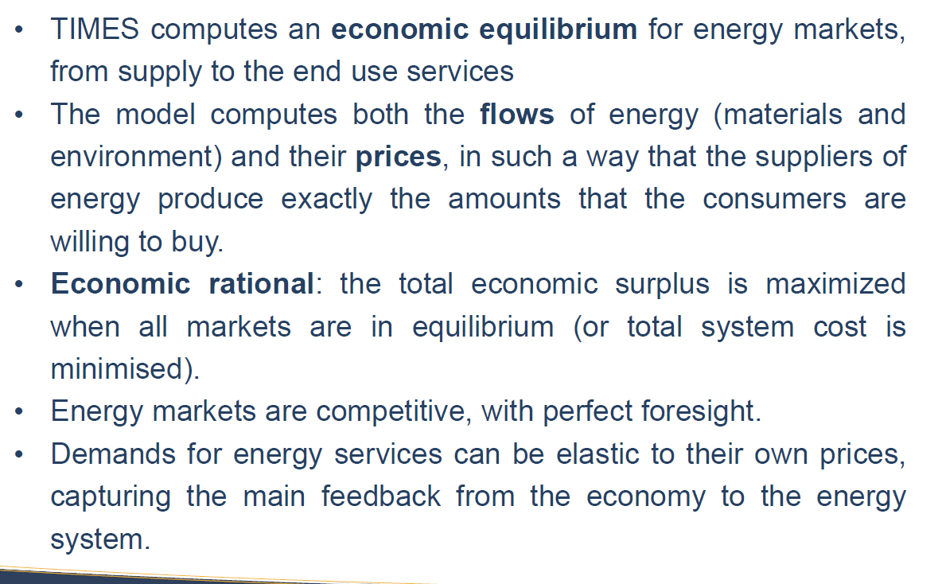

Slide 67
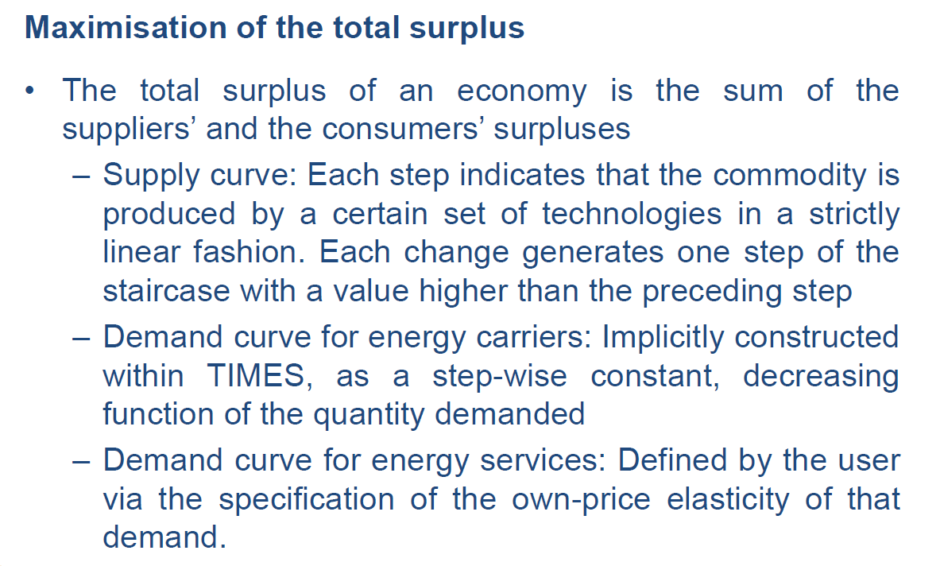

Slide 68
